Slide 1
Overview of Performance Analytics in the Insurance Industry
Gordana Savić, Isidora Gaćeša, Milan Martić,
University of Belgrade
Faculty of Organizational Sciences, Belgrade, Serbia

Slide 2
Performance Analytics in the Insurance Industry
A resilient insurance industry plays a crucial role in shaping the overall economy of a nation.
Performance analytics contributes to the insurance industry by:
Enabling more informed and effective decision-making, boosting productivity and efficiency
Helping insurers quantify risk, automate processes, and improve customer satisfaction
Allowing anticipation of trends, fine-tuning risk models, and updating strategies
Supporting monitoring, evaluation, and improvement of overall performance
Driving innovation, long-term success, and competitiveness in the market
The objective of this research is to examine the application of performance analytics in the insurance industry and its contribution to business improvement, risk management, and competitiveness.

Slide 3
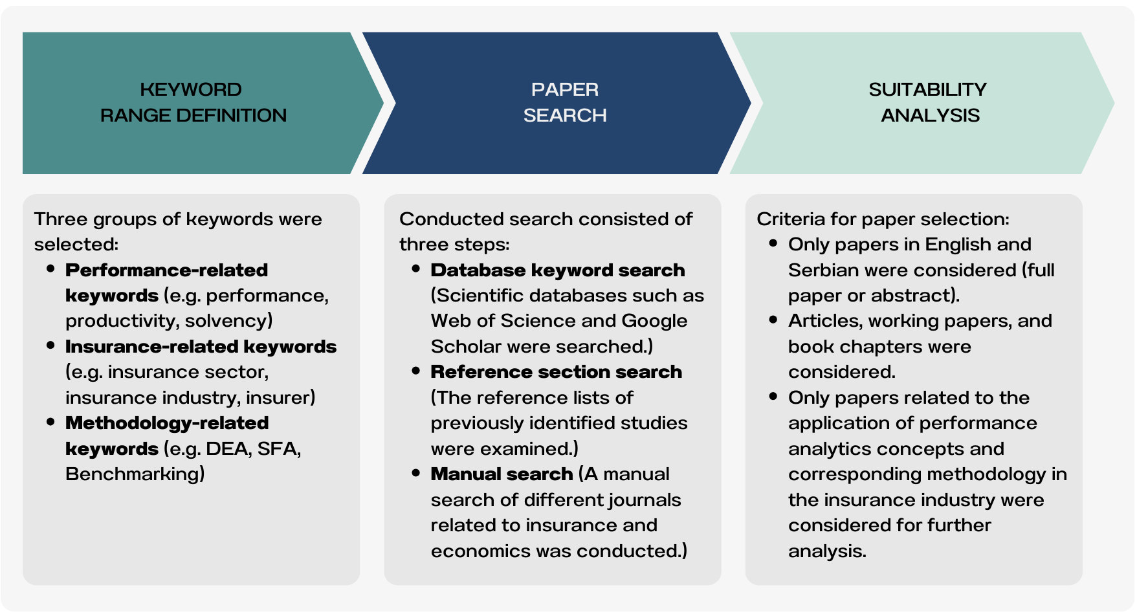
Literature Search and Screening Methodology
Search
procedure
Papers found: 84
79 → screened to 63 → +5 from references → +16 manual search

Slide 4
Statistical analysis
Publication trend (2020- 2024) | Publication sources | Keywords analysis
Sharp growth from 2020 to 2022 | 84 papers from 66 sources | 244 keywords in total
Peak in 2022 with 25 papers (~29.4% of total) | Top 14 sources published 32 papers (~38%) | The average number of keywords per paper is 5.03.
Peak in 2022 with 25 papers (~29.4% of total) Positive feedback | Majority of papers fall in economics, finance, risk management, business, public and healthcare policy Percentage (%) | Top performance keywords: Efficiency (21), Insurance companies (18), Insurance (12)
 |  | Top methodology keywords: Data Envelopment Analysis (15), Technical efficiency (11), DEA (10)

Slide 5
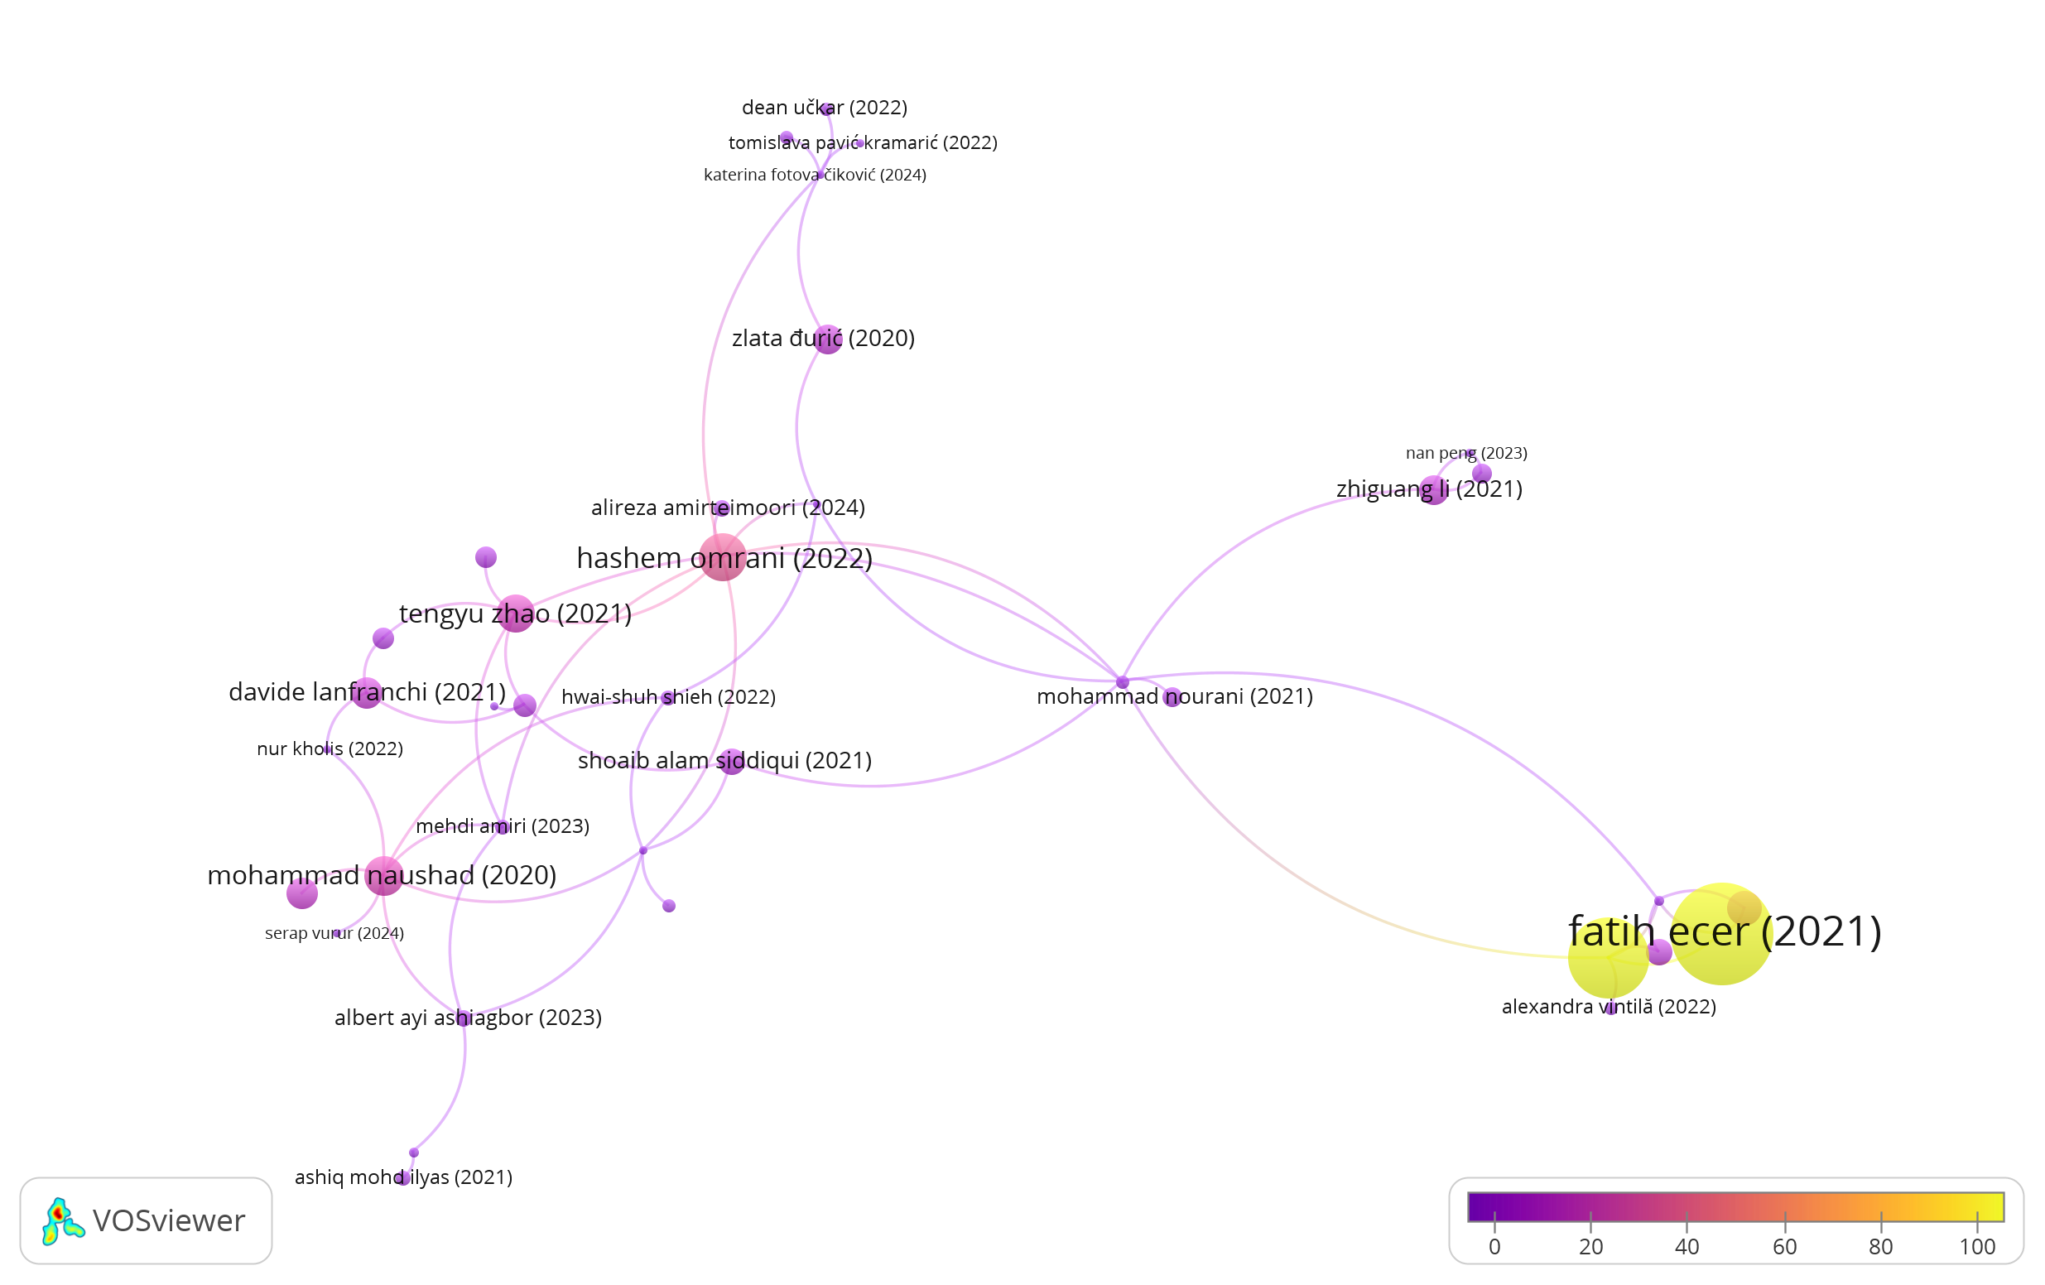
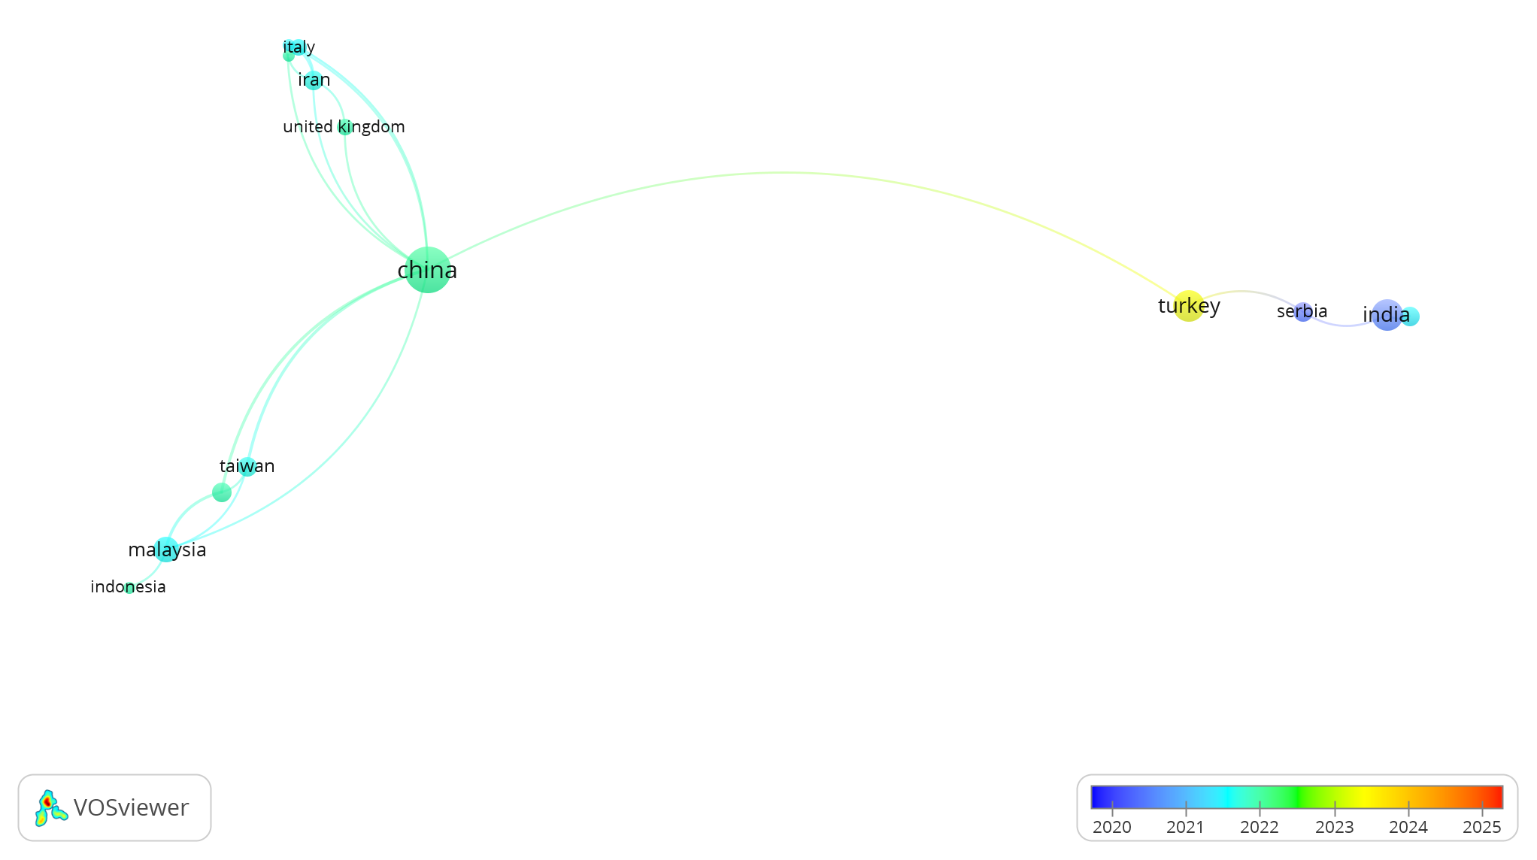
Bibliometric evaluation
Citation Analysis:
Most cited paper: Ecer & Pamučar (2021); Omrani et al. (2022) has most connections
Main method: Data Envelopment Analysis (DEA)
Central journal: Decision Making Applications in Management and Engineering
Top authors: Dragan Pamučar, Abbas Mardani, Ramin Beiragh (~100 citations) + Maja Pervan and Ana Krstic
Co-authorship Analysis:
Leading institutions mainly Chinese; Beijing University of Technology and Chinese Academy of Sciences most influential
Top countries: China, Italy, Iran, UK, Taiwan, Malaysia, Indonesia
Serbia has most co-authorships with India (2020-2021)

Slide 6
Key findings from Non-DEA Performance Studies
Topic | Main Conclusions | Example Methods
Analysis Methods | Panel data and SFA are most commonly used. Hybrid and fuzzy models are increasing. | Panel data, SFA, MARCOS, PFAHP, BSC+BWM
Focus Areas | Governance, efficiency, and external economic and regulatory influences are key themes. | Corporate governance, efficiency, inflation, regulations
Data & Scope | Longitudinal panel data with large and small samples. | Studies spanning 10-20 years, samples from 11 to 248 firms
Integrated Approaches | Combining methods for improved ranking and evaluation. | PSI-SD + MABAC, PFAHP + MAIRCA, BSC + BWM
Panel data and SFA dominate, while hybrid and multi-criteria models are gaining ground. The main focus areas include governance, efficiency, and external factors, with long-term analyses and varying sample sizes.

Slide 7
Key findings from Non-DEA Performance Studies

Slide 8
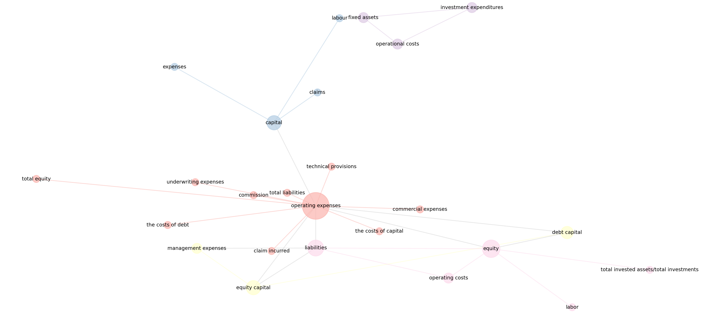
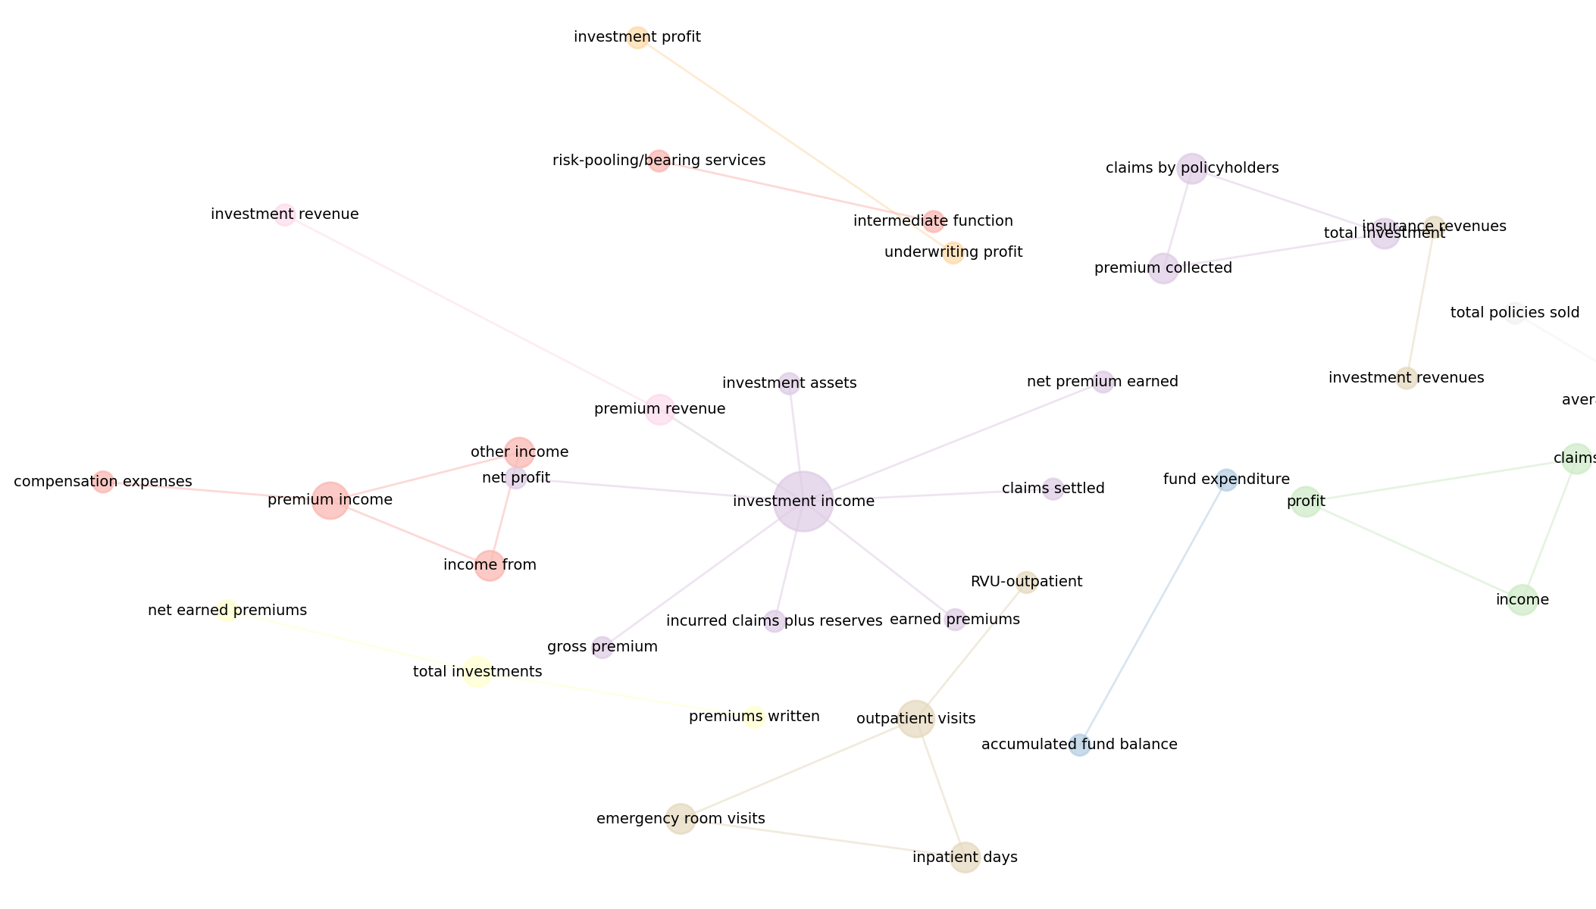
Inputs and Outputs in DEA Analysis
A total of 94 inputs & 90 outputs used.
Input Clusters
Operational costs cluster: operating expenses, underwriting expenses, liabilities
Capital-related cluster: labour, capital
Output Clusters
Income cluster: investment income, net profit, premiums
Input network
Output network

Slide 9
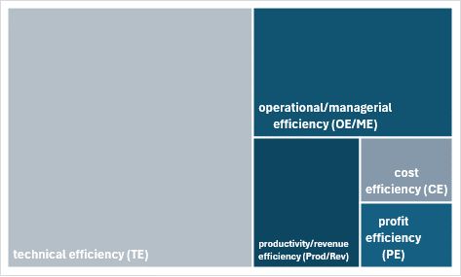
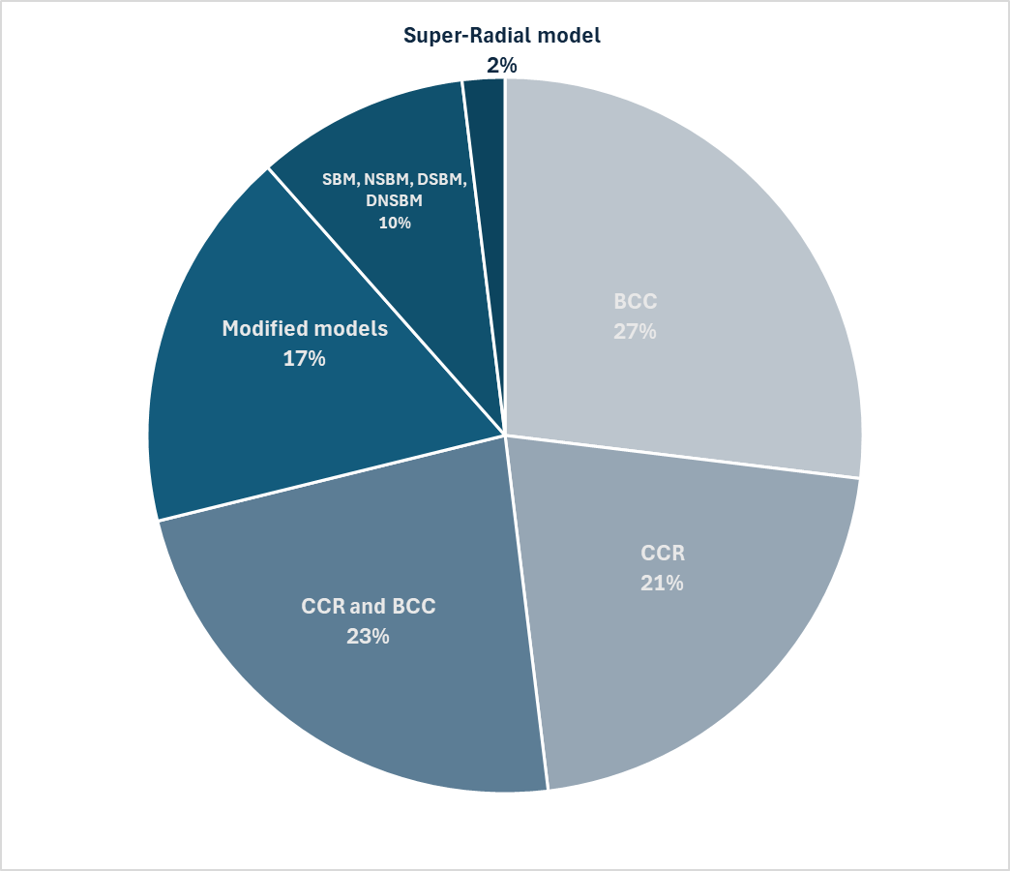
DEA Models, Efficiency Types & Advanced Methods in Insurance Studies
Category | Details
DEA Variants | Basic DEA, Multistage (2-stage, 3-stage, dynamic), Fuzzy, Robust, Network DEA
Hybrid Methods | DEA combined with ANN, Genetic Algorithms, AHP, PCA
Efficiency Types Measured | Technical, Cost, Profit, Scale, Allocative efficiency
Malmquist Indices | Productivity change, Technological progress, TFP growth
Efficiency types
DEA models

Slide 10
Discussion and Conclusion
This summary highlights key findings from a bibliometric and content analysis of performance analytics in the insurance sector, with a focus on methodological trends, efficiency metrics, and evolving research priorities.
Key points:
Performance analytics is applied across business levels, especially in insurance companies.
Healthcare insurance is the most frequent focus in related studies.
Efficiency analysis is the leading keyword in the past five years.
DEA (Data Envelopment Analysis) is the most commonly used method due to its flexibility with multiple inputs and outputs.
Advanced DEA models include dynamic analysis and Malmquist indices.
Input cluster analysis highlights the need to control resources, costs, labor, and capital.
Output indicators are income-related: investment income, net profit, earned and gross premiums.
Non-DEA studies explore corporate governance and environmental performance as additional performance factors.

